Slide 1
Practical Statistics for Data science Review
Exploratory Data Analysis

Slide 2
Chapter 1
Exploratory Data Analysis

Slide 3
EDA Exploratory Data Analysis
First step in any data project: exploring the data.
Classical statistics focused on inference:
complex set of procedures for drawing conclusions about large populations based on small samples
Testing hypothesis
Punctual and Interval estimation

Slide 4
Elements of structured data
Data comes from many sources! Much of this data is unstructured.
There are two basics types of structured data: numeric and categorical.
Numeric
Continuous | Any value or interval | Interval, float, numeric
Discrete | Only integer values | Integer, count
Categorical
Categorical | Categories | Enums, factors, nominal
Binary | Two categories | Dichotomous, logical, Boolean
Ordinal | Categorical that has explicit order | Ordered factor

Slide 5
Elements of structured data
Knowing the data type is important to help determine that type of visual display, data analysis or statistical model.
Data science software, (R/python) uses these data types to improve computational performance. The data type for a variable determines how software will handle computations for that variable.

Slide 6
Rectangular data
The typical frame of reference for an analysis in data science is a rectangular data object, like a spreadsheet or database table
Data frame:
Rectangular data is the basic data structure for statistical and machine learning models
Feature:
A column in the table is commonly referred to as a feature. (attribute, input, predictor, independent variable)
Outcome:
The features are sometimes used to predict the outcome. (dependent variable, response, target, output)
Records:
A row in the table is commonly referred to as a record. (case, example, instance, observation, pattern, sample)

Slide 7
Data frames and indexes
R
Python
data.frame object
An automatic index is created for a data.frame based on the order of the rows.
Doesn't support multilevel indexes. To overcome this use data.table or dplyr libraries.
DataFrame object (pandas).
An automatic index is created for a DataFrame based on the order of the rows.
Pandas can handle multiple indexes.

Slide 8
Nonrectangular data structures
Time series records successive measurements of the same variable.
Spatial data structures, used in mapping and location analytics.
Graph (network) used to represent physical, social and abstract relationships.

Slide 9
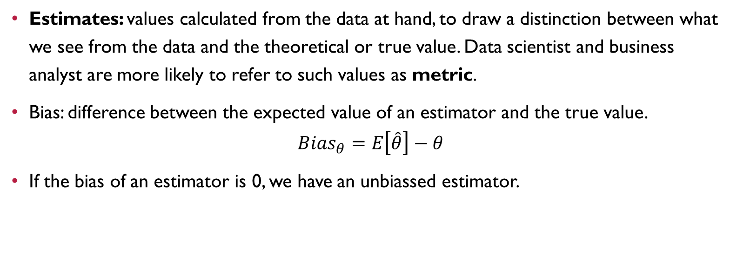
Estimates
Estimates: values calculated from the data at hand, to draw a distinction between what we see from the data and the theoretical or true value. Data scientist and business analyst are more likely to refer to such values as metric.
Bias: difference between the expected value of an estimator and the true value.
$${Bias}_{θ}=E\left[\hat{θ}\right]−θ$$
If the bias of an estimator is 0, we have an unbiassed estimator.

Slide 10
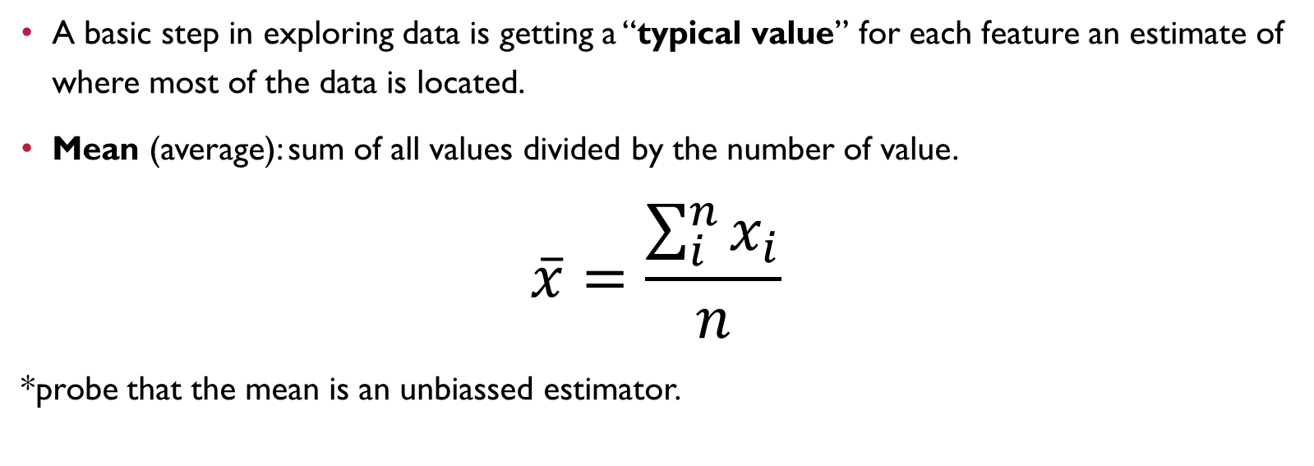
Estimates of location
A basic step in exploring data is getting a “typical value” for each feature an estimate of where most of the data is located.
Mean (average): sum of all values divided by the number of value.
$$\overline{x}=\frac{\sum_{i}^{n}{x_{i}}}{n}$$
*probe that the mean is an unbiassed estimator.

Slide 11
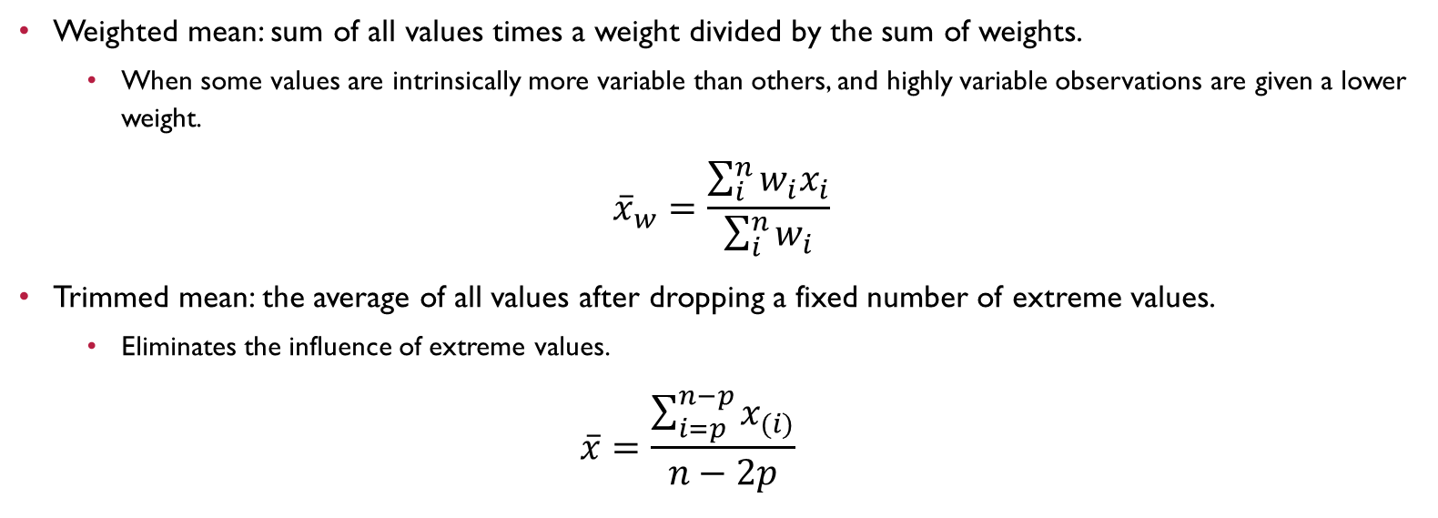
Weighted mean: sum of all values times a weight divided by the sum of weights.
When some values are intrinsically more variable than others, and highly variable observations are given a lower weight.
$${\overline{x}}_{w}=\frac{\sum_{i}^{n}{w_{i}x_{i}}}{\sum_{i}^{n}{w_{i}}}$$
Trimmed mean: the average of all values after dropping a fixed number of extreme values.
Eliminates the influence of extreme values.
$$\overline{x}=\frac{\sum_{i=p}^{n−p}{x_{(i)}}}{n−2p}$$

Slide 12
Robust estimates
Robust: Not sensitive to extreme values
Outlier: A data value that is very different from most of the data
Median (50th percentile): The value such that one half of the data lies above and below.
Weighted median: The value such that one half of the sum of the weights lies above and below the sorted data.

Slide 13
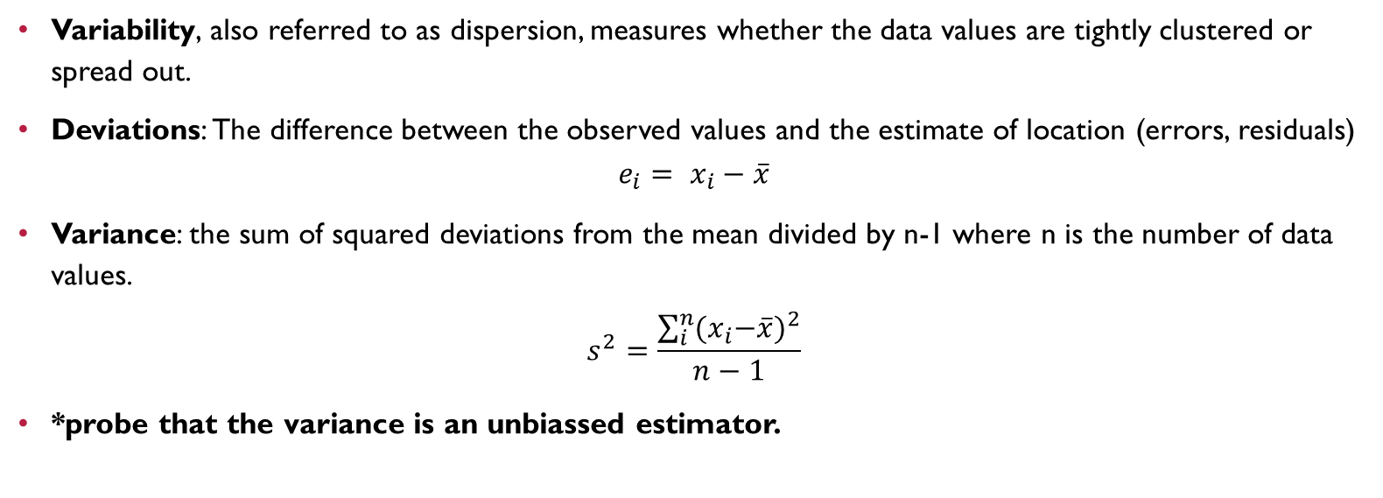
Estimates of variability
Variability, also referred to as dispersion, measures whether the data values are tightly clustered or spread out.
Deviations: The difference between the observed values and the estimate of location (errors, residuals)
$$e_{i}= x_{i}−\overline{x}$$
Variance: the sum of squared deviations from the mean divided by n-1 where n is the number of data values.
$$s^{2}=\frac{\sum_{i}^{n}{{(x}_{i}−\overline{x}})^{2}}{n−1}$$
*probe that the variance is an unbiassed estimator.

Slide 14
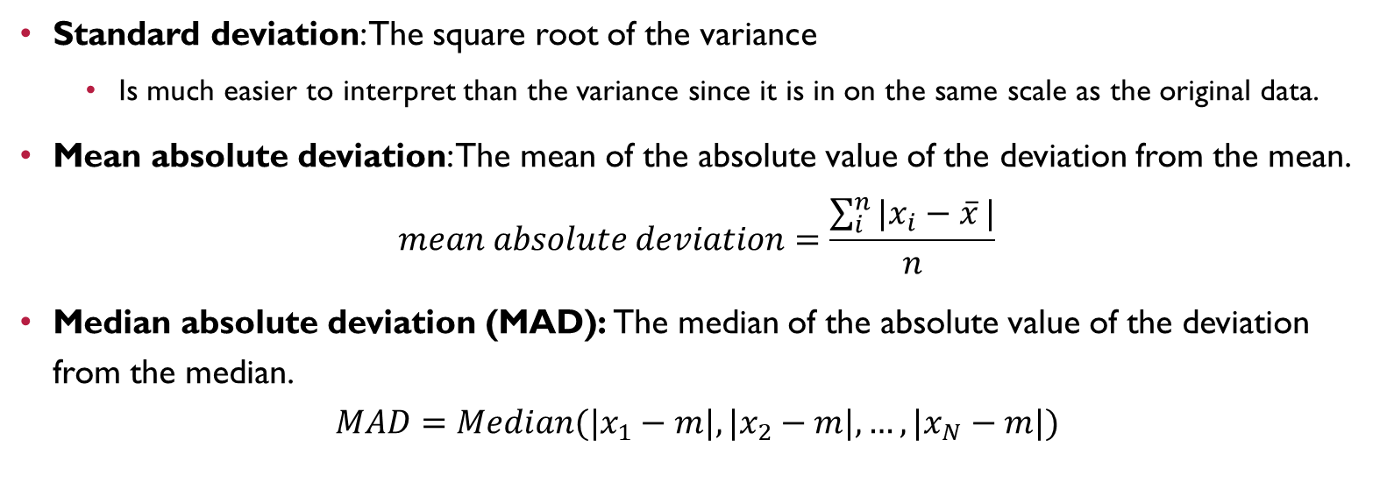
Standard deviation: The square root of the variance
Is much easier to interpret than the variance since it is in on the same scale as the original data.
Mean absolute deviation: The mean of the absolute value of the deviation from the mean.
$$mean absolute deviation=\frac{\sum_{i}^{n}{{|x}_{i}−\overline{x}}|}{n}$$
Median absolute deviation (MAD): The median of the absolute value of the deviation from the median.
$$MAD=Median(|x_{1}−m|,|x_{2}−m|,…,|x_{N}−m|)$$

Slide 15
Estimated based on percentiles
A different approach to estimating dispersion is based on looking at the spread of the sorted data. Also known as order statistics.
Range: The difference between the largest and the smallest value in a data set. (ranks)
Percentile: The value such that P percent of the values take on this value or less and (100-P) percent take on this value or more. (quantile)
Interquartile range: The difference between the 75th percentile and the 25th percentile. (IQR)

Slide 16
Exploring the Data distribution
Estimators are useful to explore how data is distributed, overall.
There are a groups of tools that provide us insights about the data distribution:
Boxplot (box and whiskers plot)
Frequency table
Histogram
Density plot

Slide 17
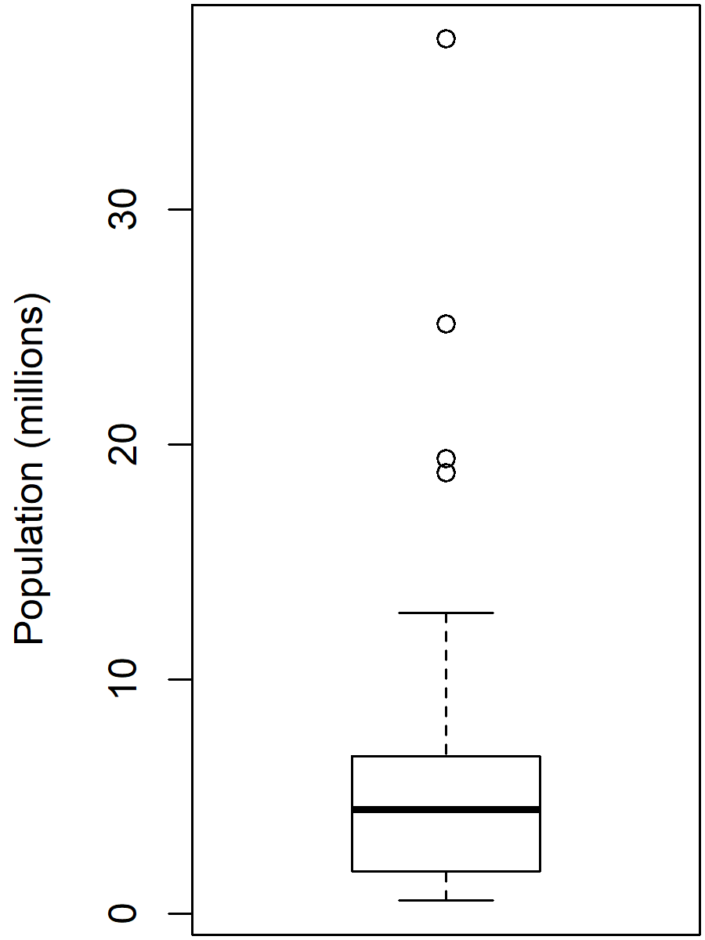
Percentiles and boxplots

Slide 18
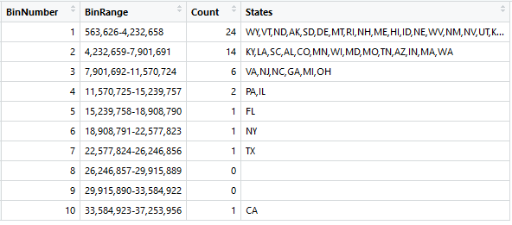
Frequency tables

Slide 19
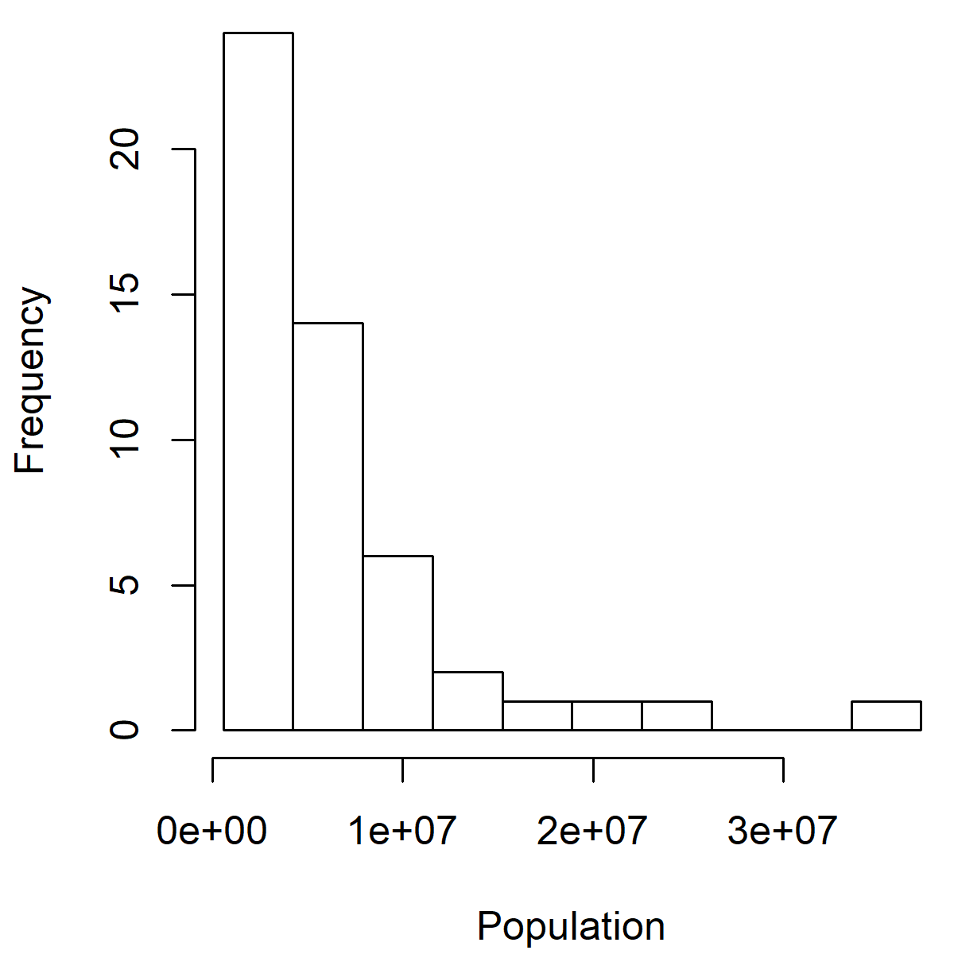
histograms

Slide 20
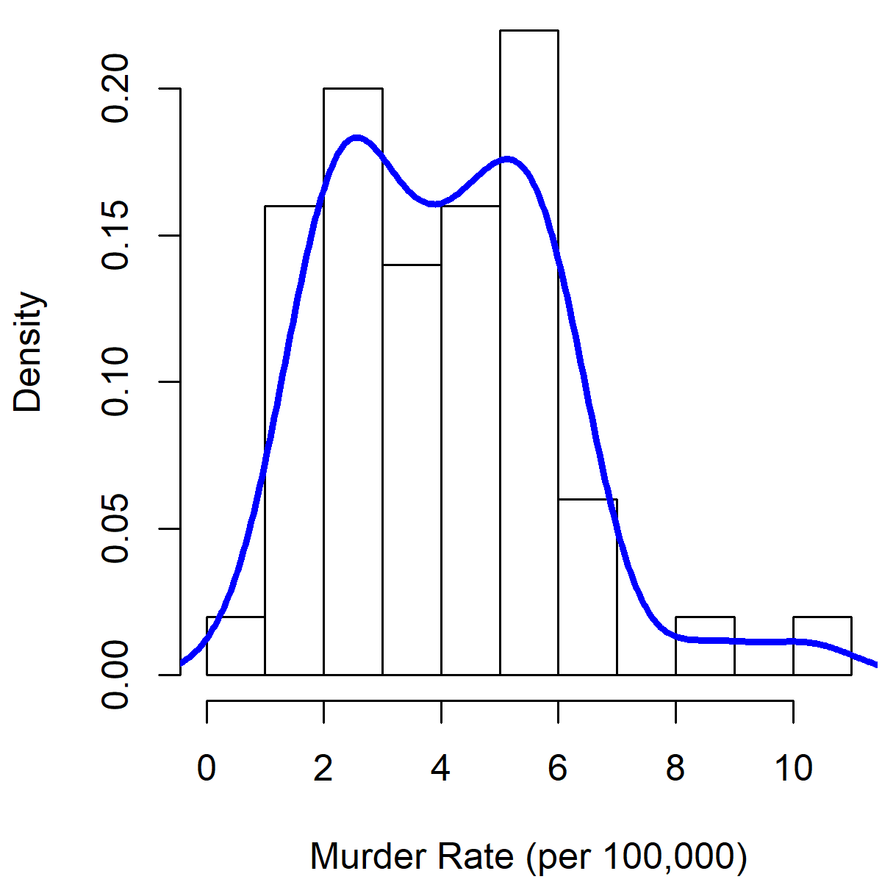
Density estimates

Slide 21
Exploring Binary and categorical data
For categorical data, simple proportions or percentages tell the story of the data.
Mode: The most commonly occurring category or value in a data set.
Expected value: When the categories can be associated with a numeric value, this gives an average value based on a category’s probability of occurrence.
Bar charts: The frequency or proportion for each category plotted as bars.
Pie charts: The frequency or proportion for each category plotted as wedges in a pie.

Slide 22
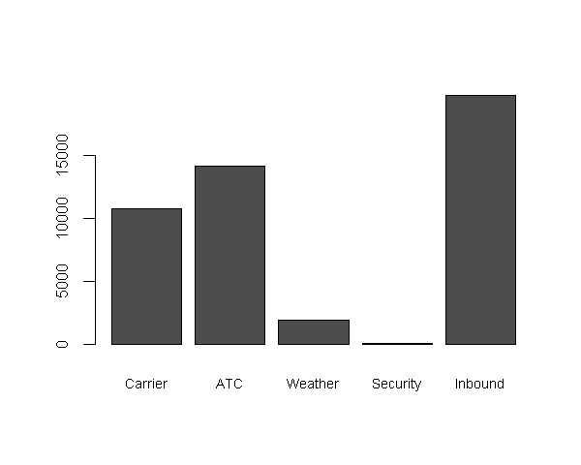
Bar chart
Bar chart resembles a histogram’ in a bar chart the x-axis represents different categories of a factor variable, while in a histogram the x-axis represents values of a single variable on a numeric scale.

Slide 23
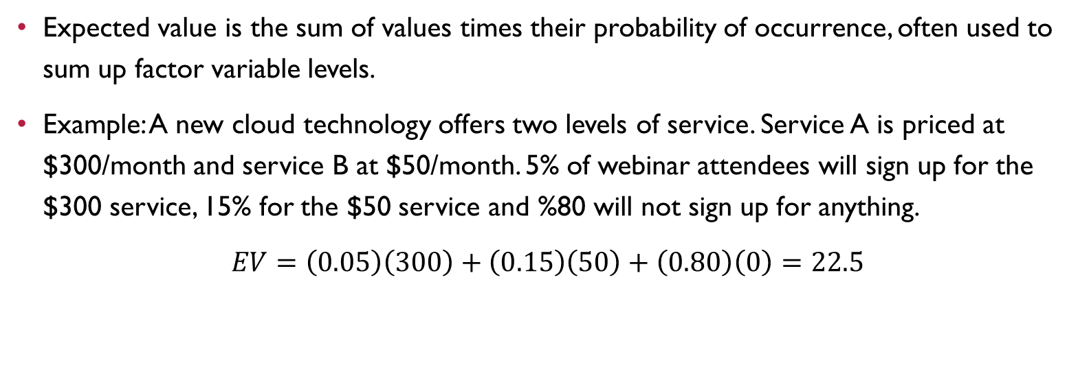
Expected value
Expected value is the sum of values times their probability of occurrence, often used to sum up factor variable levels.
Example: A new cloud technology offers two levels of service. Service A is priced at $300/month and service B at $50/month. 5% of webinar attendees will sign up for the $300 service, 15% for the $50 service and %80 will not sign up for anything.
$EV=\left(0.05\right)\left(300\right)+\left(0.15\right)\left(50\right)+\left(0.80\right)\left(0\right)=22.5$

Slide 24
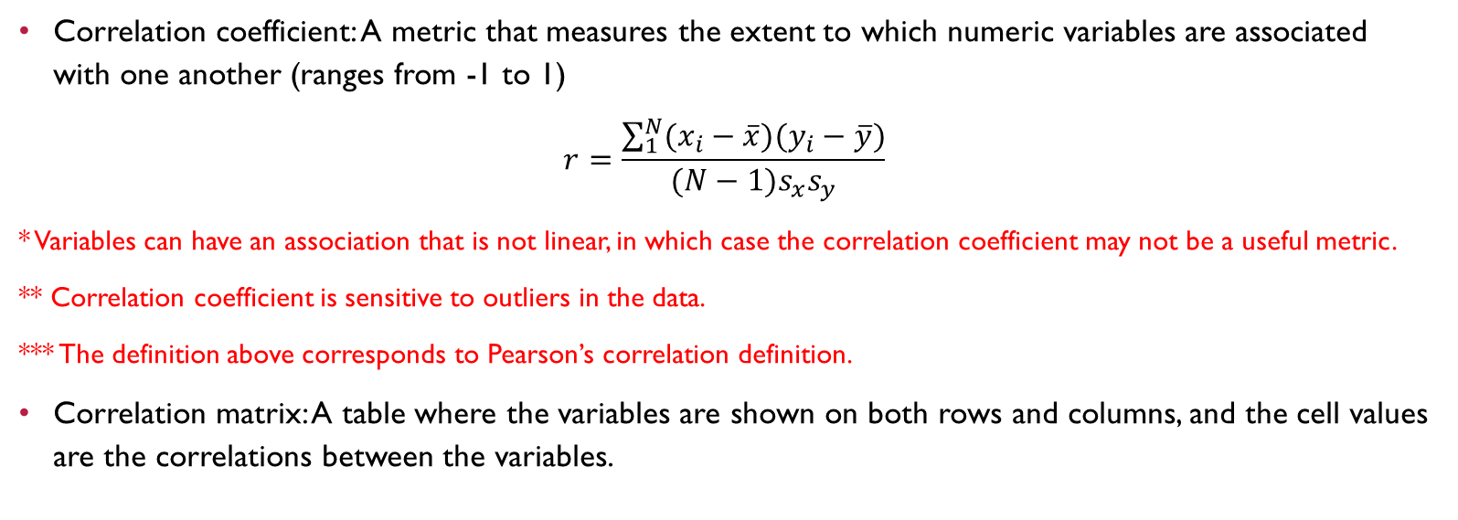
Correlation
Correlation coefficient: A metric that measures the extent to which numeric variables are associated with one another (ranges from -1 to 1)
$$r=\frac{\sum_{1}^{N}{(x_{i}−\overline{x})(y_{i}−\overline{y})}}{(N−1)s_{x}s_{y}}$$
* Variables can have an association that is not linear, in which case the correlation coefficient may not be a useful metric.
** Correlation coefficient is sensitive to outliers in the data.
*** The definition above corresponds to Pearson’s correlation definition.
Correlation matrix: A table where the variables are shown on both rows and columns, and the cell values are the correlations between the variables.

Slide 25
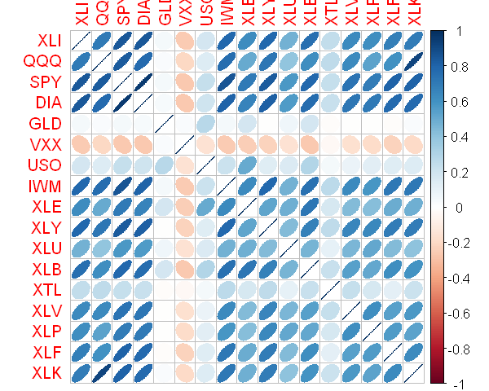
Corrplot

Slide 26
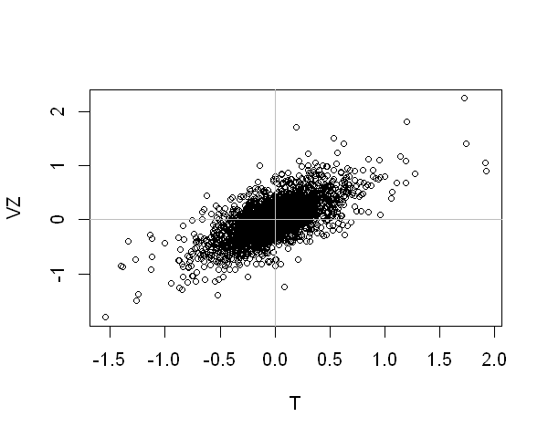
scatterplots
The standard way to visualize the relationship between two measured data variables is with a scatterplot

Slide 27
Exploring two or more variables
Multivariate exploratory analysis tools:
Hexagonal binning: A plot of two numeric variables with the records binned into hexagons.
Contour plots: A plot showing the density of two numeric variables like a topographical map.
Violin plots: Similar to a boxplot but showing the density estimate.

Slide 28
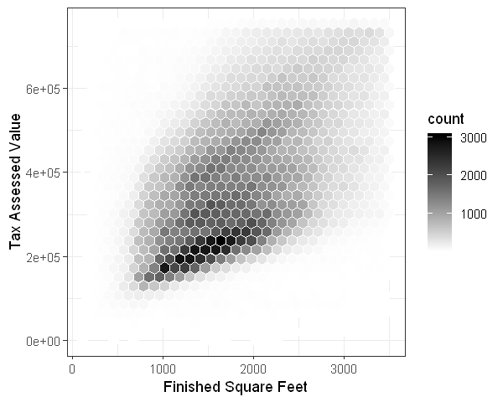
Hexagonal binning
For dataset with hundreds of thousands or millions od records, a scatterplot will be too dense, so we need a different way to visualize the relationship. Dots are grouped into hexagonal bins a plotted the hexagons with a color indicating the number of records in that bin.

Slide 29
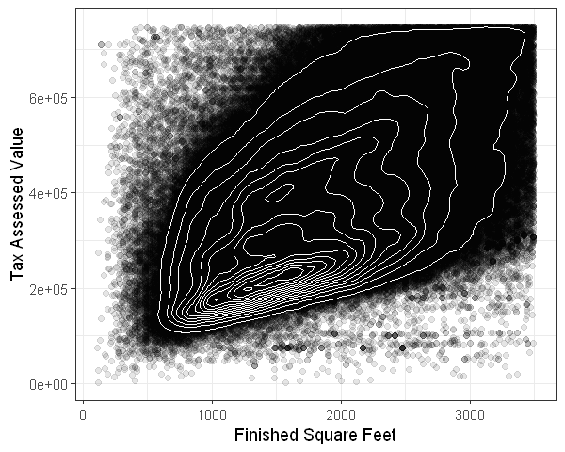
Contours and heatmaps
We can overlay a contour on a scatterplot to visualize the relationship between two numeric variables. The contours are essentially a topographical map to two variables; each contour band represent a specific density of points, increasing as one nears a “peak”.

Slide 30
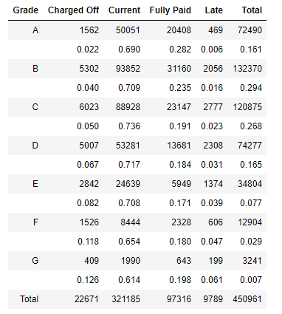
Two categorical variables
Contingency tables: A tally of counts between two or more categorical variables.

Slide 31
Categorical and numeric data
Boxplots are a simple way to visually compare the distribution of a numeric variable grouped according to a categorical variable.
A violin plot is an enhancement to the boxplot and plots the density estimate with the density on the y-axis. The advantage of a violin plot is that it can show nuances in the distribution that aren’t receptible in a boxplot.

Slide 32
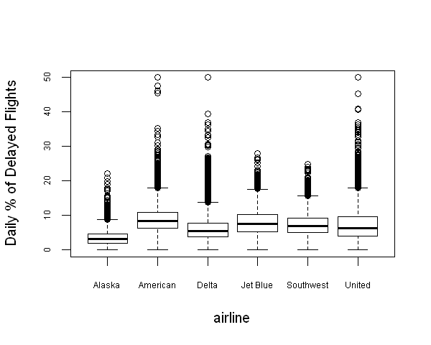
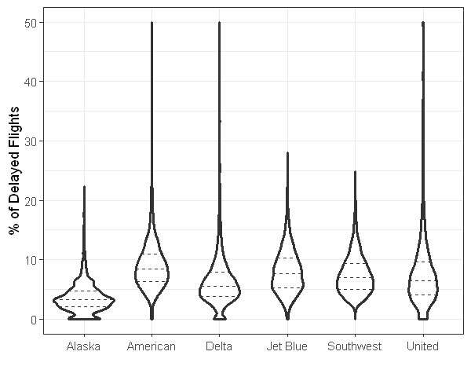
Categorical and numeric data
Boxplot
Violin plot

Slide 33
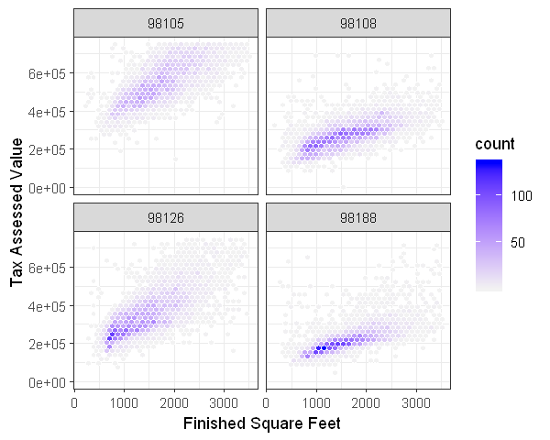
Visualizing multiple variables

Slide 34
Summary
Key idea of EDA: Look at the Data!!!
By summarizing and visualization the data, you can give valuable intuition and understanding of the project.
EDA should be a cornerstone of any data science project

Slide 35
Chapter 2
Data and Sampling distributions

